Slide 1
Important Note Regarding This Microsoft PowerPoint Presentation
* Do not include this slide in your presentation *
This slide deck has been intentionally provided with very limited graphics and formatting to simplify content integration into your own preferred PowerPoint themes and styles.

Slide 2
Security Development Lifecycle (SDL) Field Content
Banned APIs
(Level 200)

Slide 3
Agenda
Overview of the Microsoft SDL
Overview of the Microsoft SDL Banned APIs
Methods for detecting banned functions
Overview of safer alternatives
StrSafe
Safe CRT

Slide 4

Microsoft Security Development Lifecycle (SDL)
Training
Requirem-ents
Design
Implemen-tation
Verification
Release
Response
Delivering secure software requires:
Executive commitment → SDL a mandatory policy at Microsoft since 2004
Education
Technology and Process
Accountability
Ongoing Process Improvements → 6 month cycle

Slide 5
Microsoft SDL Banned APIs Overview
Microsoft SDL Banned APIs: A documented list of function calls and libraries that are prohibited for use by new applications and legacy applications.
Incorrect use can lead to serious vulnerabilities
Effective way to help reduce risk
The Microsoft SDL Banned APIs list is not a static list
Also applicable to non-Microsoft platforms
Useful when source code is available

Slide 6
Examples of Microsoft SDL Banned APIs
Banned Copy Functions | strcpy, wcscpy, _tcscpy, _mbscpy, strCpy, strCpyA, strCpyW, lstrcpy, lstrcpyA, lstrcpy, _tccpy, _mbccpy
Banned Concatenation Functions | strcat, wcscat, _tcscat, _mbscat, StrCatBuffW, StrCatBuff, StrCatBuffA, StrCatChainW, _tccat, _mbccat
Banned OEM Conversion Functions | CharToOem, CharToOemA, ChartoOemW, OemToChar, OemToCharA, OemToCharW, CharToOemBuffA, CharToOemBuffW
Banned String Length Functions | strlen, wcslen, _mbslen, _mbstrlen, lstrlen
More than 100 different functions have been banned and corresponding safer alternatives have been documented
See http://msdn.microsoft.com/en-us/library/bb288454.aspx for more information

Slide 7
Examples of Real-World Risks from Banned APIs
Microsoft Bulletin Number | Product | Function | Risk
MS02-039 | SQL Server 2000 | sprintf | Remote code execution
MS03-045 | Windows (User) | wcscpy | Local elevation of privileges
MS04-011 | Windows (DCPromo) | wvsprintf | Remote code execution
MS04-011 | Windows (MSGina) | lstrcpy | Remote code execution
MS04-031 | Windows (NetDDE) | wcscat | Remote code execution
For more information regarding these and other bulletins, visit http://www.microsoft.com/technet/security/current.aspx

Slide 8
The “n” Functions Are Also Banned
The C runtime “n” functions are also banned
Not suitable as alternatives to other banned APIs per the Microsoft SDL
Too difficult for developers to call correctly
Does not include null-termination of overflowed buffers
Does not provide error information when a buffer overflow occurs

Slide 9
Unsafe “n” Function Example
#include <stdio.h>
#define MAX (50)
void Function(char * pszSrc)
{
// Allocate 50 bytes onto the stack char szDest[MAX];
// Copy MAX bytes
strncpy(szDest,pszSrc,MAX);
// Perform some operation with szDest
}
szDest is not null-terminated if length of pszSrc >= MAX
Extra care to prevent buffer overflows is still required when using n-functions

Slide 10
Detecting Instances of Banned APIs
Visual Studio 2005 and higher built-in detection
Investigate all C4996 warnings and all #pragma warning(disable:4996) instances
Microsoft SDL book banned.h header file
http://download.microsoft.com/download/2/e/b/2ebac853-63b7-49b4-b66f-9fd85f37c0f5/banned.h
Security code review

Slide 11
Microsoft SDL Banned API Alternatives
Safer alternative libraries:
StrSafe library
Safe CRT library
(Optional) Standard C++ std::string template class defined in ISO/IEC 14882
Important Note: Alternatives to banned functions are not “silver bullets”
Still requires developers to verify that destination buffer sizes are correct

Slide 12
Safer Alternative #1: StrSafe
Provides additional processing for proper buffer handling for C/C++ applications
See http://msdn.microsoft.com/en-us/library/ms647466(VS.85).aspx
Available through the Windows Core SDK
See http://msdn.microsoft.com/en-us/windowsserver/bb980924.aspx
Advantages:
Guaranteed null termination
All functions provide return codes
All functions require size of destination buffer parameter

Slide 13
StrSafe Example
Example with banned function strcpy and strcat: <NOT SAFE>
void Function(char * s1, char * s2)
{ char temp[32];
strcpy(temp,s1);
strcat(temp,s2); }
Example with StrSafe: <SAFER>
#include <strsafe.h>
HRESULT Function(char * s1, char *s2)
{
char temp[32];
HRESULT hr = StringCchCopy(temp,_countof(temp),s1);
if (FAILED(hr)) return(hr);
return(StringCchCat(temp,_countof(temp),s2));
}

Slide 14
Safer Alternative #2: Safe CRT
Distributed with Microsoft Visual Studio 2005 and higher
Security enhancements to the C runtime
Several CRT functions now have more secure versions
See http://msdn.microsoft.com/en-us/library/8ef0s5kh(VS.80).aspx
Advantages:
Secure Template Overloads (see http://msdn.microsoft.com/en-us/library/ms175759(VS.80).aspx) when _CRT_SECURE_CPP_OVERLOAD_STANDARD_NAMES is defined

Slide 15
Safe CRT Example
Example with banned function strcpy: <NOT SAFE>
void Function(char * s1)
{ char temp[32];
strcpy(temp,s1); }
Example with Safe CRT Secure Template Overloads: <SAFER>
#define _CRT_SECURE_CPP_OVERLOAD_STANDARD_NAMES 1
void Function(char * s1)
{
char temp[32];
// Compiler will automatically convert strcpy to strcpy_s, and provide
// the size argument automatically
strcpy_s(temp,32,s1);
}

Slide 16
Choosing StrSafe Versus Safe CRT
Engineering Scenario | StrSafe Library | Safe CRT Library
Distribution Method | Online via MSDN | Microsoft Visual Studio 2005 or higher
Number of Headers | One | Numerous
Library Version Available | Yes | Yes
Inline Version Available | Yes | No
Industry Standard | No | Under consideration
Kernel Mode | Yes | No
Return Types | HRESULT (user) or NTSTATUS (kernel) | Depends on the function
Requires Code Changes | Yes | Yes
Main Focus | Buffer overflows | Buffer overflows and other vulnerabilities

Slide 17
Conclusion
Overview of Microsoft SDL
Overview of Microsoft SDL Banned APIs
Detecting instances of banned functions
Overview of safer alternatives

Slide 18
Appendix

Slide 19


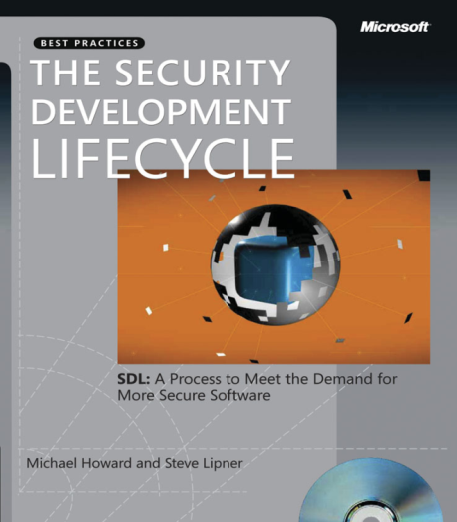


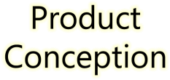























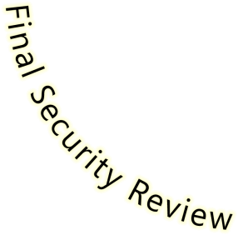


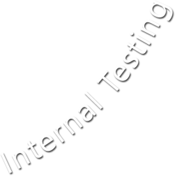





Microsoft Security Development Lifecycle (SDL)
SDL Book:
http://www.microsoft.com/mspress/books/8753.aspx
Official SDL Web Site: http://www.microsoft.com/sdl

Slide 20
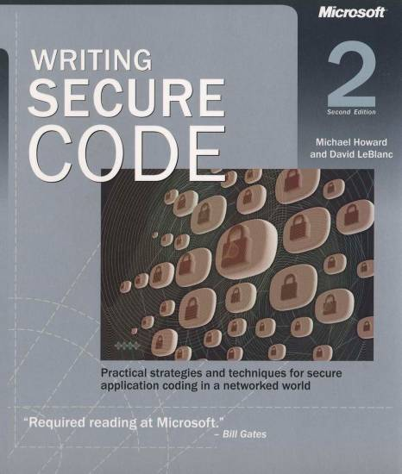
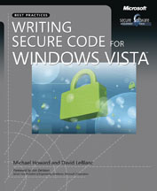
Microsoft Writing Secure Code Book Series
Writing Secure Code,
2nd Edition:
http://www.microsoft.com/mspress/books/5957.aspx
Writing Secure Code for Windows Vista:
http://www.microsoft.com/mspress/books/10723.aspx

Slide 21
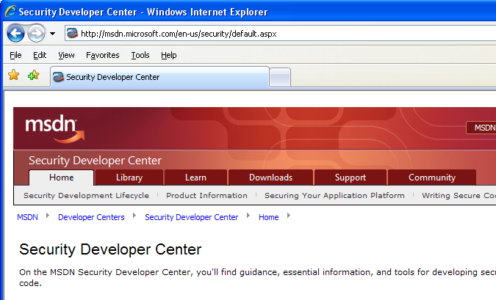

Microsoft Developer Network (MSDN) Security Developer Center
Official Web site: http://msdn.microsoft.com/security

Slide 22
Secure Development Blogs
The Microsoft Security Development Lifecycle (SDL) Blog: http://blogs.msdn.com/sdl
Michael Howard’s Blog: http://blogs.msdn.com/michael_howard

Slide 23
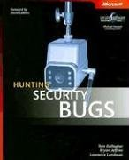
Microsoft Hunting Security Bugs
Hunting Security Bugs:
http://www.microsoft.com/mspress/books/8485.aspx

Slide 24
Additional SDL Training Content
Secure Design Principles
Secure Implementation Principles
Secure Verification Principles
SQL Injection Vulnerabilities
Cross-Site Scripting Vulnerabilities
Buffer Overflow Vulnerabilities

Slide 25
Banned APIs Resources
Online Microsoft SDL Banned APIs information: http://msdn.microsoft.com/en-us/library/bb288454.aspx
Banned.h header file: http://download.microsoft.com/download/2/e/b/2ebac853-63b7-49b4-b66f-9fd85f37c0f5/banned.h
StrSafe library: http://msdn.microsoft.com/en-us/library/ms647466(VS.85).aspx
Safe CRT library: http://msdn.microsoft.com/en-us/library/8ef0s5kh(VS.80).aspx

